Slide 1
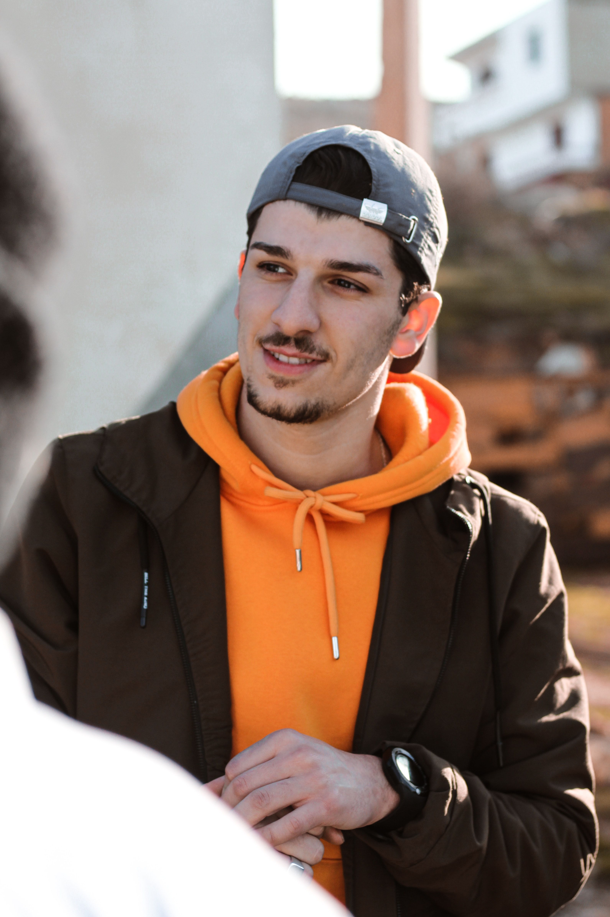
“Simplicity is the ultimate sophistication”
Add image that represents this persona
Goals
This is his first job, he wants to learn the ropes of the business for a solid foundation
Maximize time to focus on the job
Find his voice as graphic designer
Frustrations
The shop is often too crowded
Wastes a lot of time as the pick up process is a bit messy.
Dylan McFly
Age: 23
Education: Arts and design degree
Hometown: Los Gatos (CA)
Family: Single
Occupation: Junior Graphic Designer in small advertising agency
Dylan took a degree in Arts and design at San Jose State College. He’s been at an entry-level job in a small advertising agency. He wants to learn as much and as quickly as possible. He sees the task of getting coffee as a distraction from his focus, but is happy to take one for the team.

Slide 2
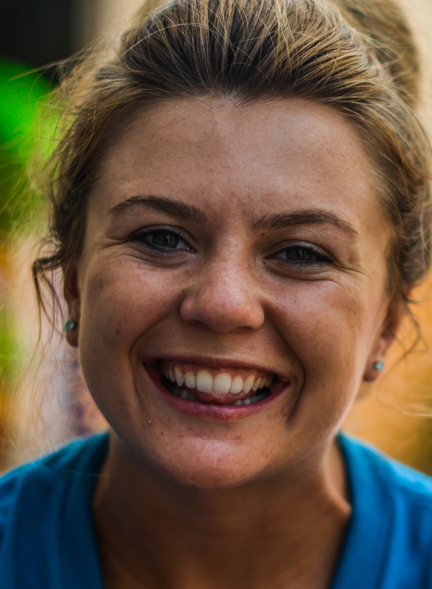
“Do or do not, but do not try”
Add image that represents this persona
Goals
Sue was let go from her job in a big corp and now freelances as consultant.
Manage time efficiently, as she’s often on the go
Grow her business as consultant
Frustrations
Very often the shop is crowded and noisy, so it is hard to focus.
The staff could be more helpful (clean the tables more swiftly, offer help when she’s got too many bags on her)
Sue Storm
Age: 52
Education: Master in Business Administration
Hometown: LA (CA)
Family: Divorced, one kid
Occupation: Independent consultant
Sue has an MBA from UCLA. She’s been freelancing for 3 years now and wants to grow her business. She is often on the go, either visiting clients or driving her daughter. Very often she will find 1 or 2 hours in between activities and needs a hub away from home to get some work done.

